Slide 1

Process Mining Virtual Internship
by
S HARIPRASAD
Roll No. 224G1A3224
Department of Computer Science and Engineering (Data Science)
Srinivasa Ramanujan Institute of Technology
(Affiliated to JNTUA & Approved by AICTE) (Accredited by NAAC with ‘A’ Grade & Accredited by NBA (EEE, ECE & CSE)
Rotarypuram Village, B K Samudram Mandal, Ananthapuramu – 515701.
2024 -2025

Slide 2

Contents
Course Objective
Introduction
Technology
Applications
Modules
Real Time applications
Learning outcomes
GitHub Link
Queries

Slide 3
Course Objective
Discover how process mining techniques can help an organization analyze and improve its business processes.
Know the usage of the process mining tool to discover, validate, and optimize workflows.
Search for the possibility of getting data-driven insights from event logs to reveal hidden inefficiencies.
Focus on the fact that process mining helps in continuous improvement through process discrepancies.

Slide 4
Introduction
Discover how process mining techniques can help an organization analyze and improve its business processes.
Know the usage of the process mining tool to discover, validate, and optimize workflows.
Search for the possibility of getting data-driven insights from event logs to reveal hidden inefficiencies.
Focus on the fact that process mining helps in continuous improvement through process discrepancies.

Slide 5
Technology
Celonis PQL: A domain-specific query language built to run process mining queries efficiently.
Automated Process Discovery: By leveraging event logs, as-is business workflows are discovered without pre-existing models.
Process Mining Algorithm: Compares runtime workflows against predefined process models to highlight deviations.
Fuzzy Miner: Dynamically visualizes complex process flows in process mining.

Slide 6
Applications
Analyze bottlenecks and deviations to optimize business processes.
Monitor for non-conformance and internal policy violations.
Improve operational efficiency by identifying and rectifying process inefficiencies.
Ensure regulatory compliance and reduce risks by detecting anomalies in process execution.

Slide 7
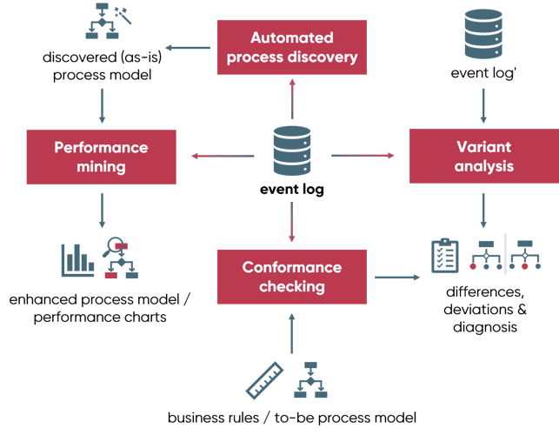
Modules
Conformance Checking: Ensures processes conform to pre-existing models, providing insights on compliance.
Performance Mining: Identifies inefficiencies and optimizes processes using actual data, reducing operational costs.
Variant Analysis: Compares multiple process variations to determine the most efficient paths.
Predictive Analytics: Predicts future process outcomes based on past event logs.

Slide 8
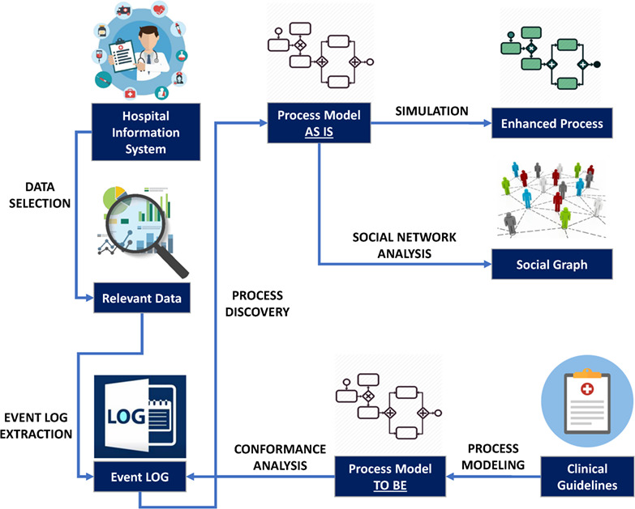
Real Time applications
Healthcare: Monitor treatment processes using electronic health records to enhance patient care workflows.
Finance: Automate financial transactions and trace fraudulent activities and inefficiencies.
Manufacturing: Optimize production line efficiency by analyzing machine and human workflows.
Retail: Optimize supply chain processes to reduce delays and improve customer satisfaction.

Slide 9
Learning outcomes
Practice using process mining tools like Celonis and Prom, and analyze the results.
Understand how process mining ensures compliance and improves process performance.
Apply data-driven process optimization techniques across various industries.
Predict process performance and recommend improvements based on insights from event logs.

Slide 10
Git Hub Dashboard

Slide 11
Any Queries?

Slide 12
Thank You!!!

